Slide 1

Tractiv - IOT based social safety app
KIIT-DU , School of Computer Engineering , Bhubaneshneshwar, India
Presented by
Shailesh Das
Shrishti
Anushmita Das
Rohit Halder

Slide 2
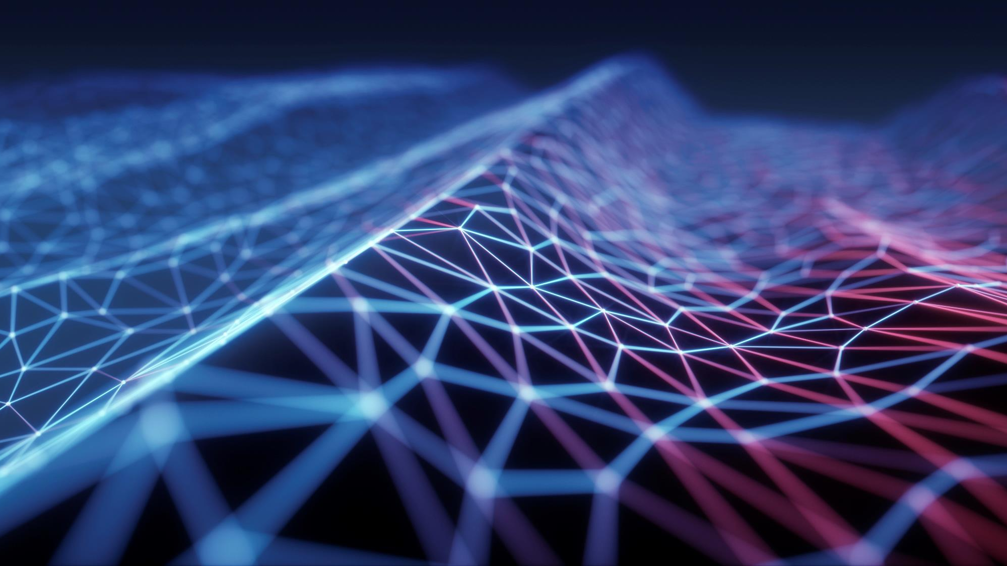
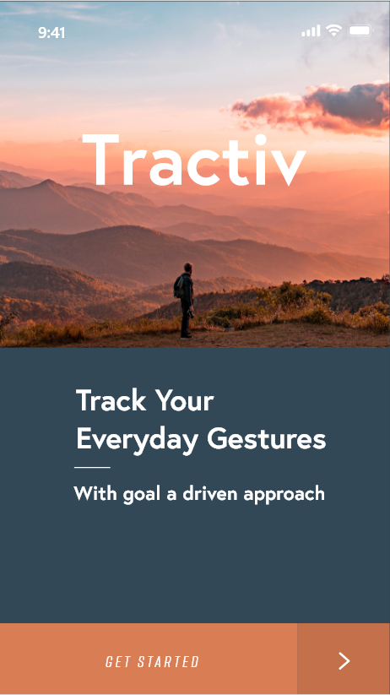

PROJECT TractIv
IOT based social safety app

Slide 3
OverView
Problem Statement
Introduction
Drawbacks of Manual System
Bliss of Automation
Project Architechture
Datasets
Efficiency of our model
Insights to our Android application
Tradeoff between Acuuracy and Latency
Conclusion
Future works

Slide 4
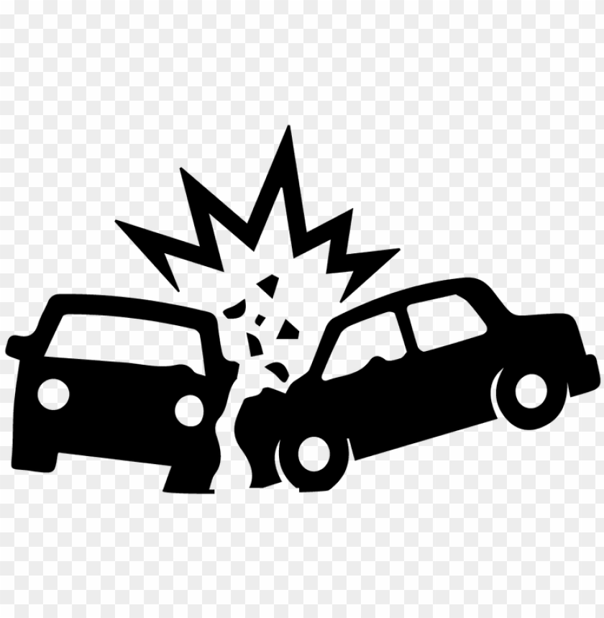
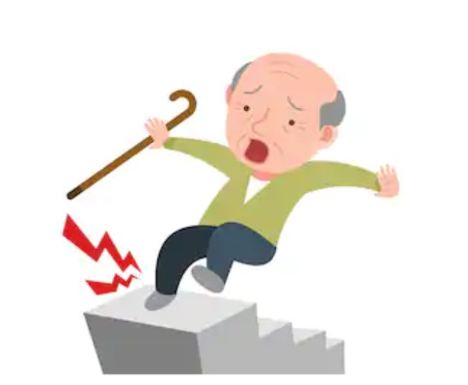
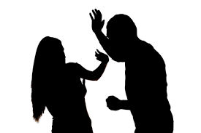
How would your acquaintances know that you are in trouble ?
Whom would you ask for help ?
How will you know your parents are safe at HOME while you are in office ?

Slide 5
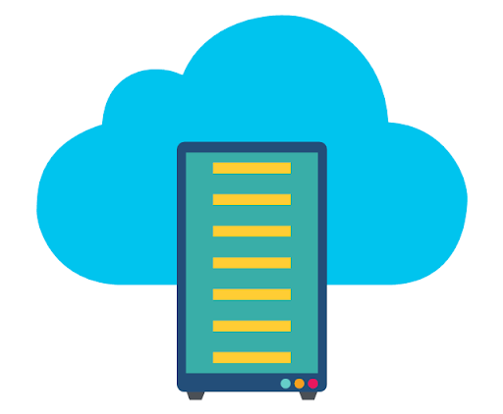
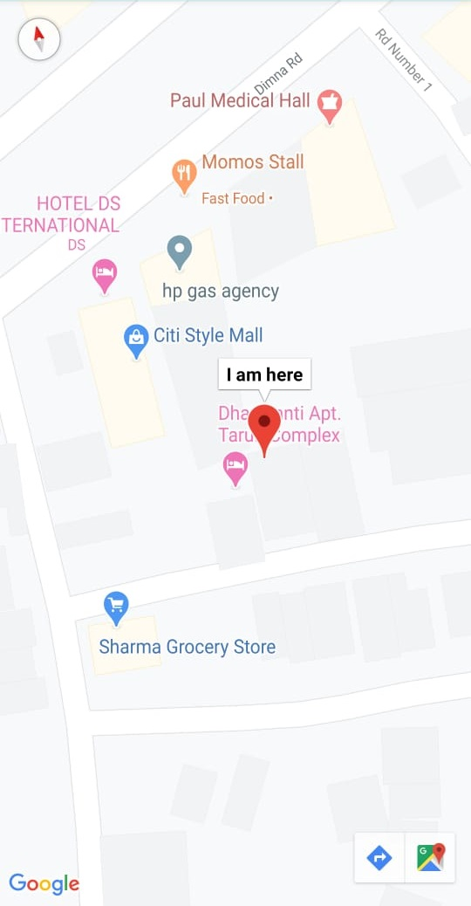
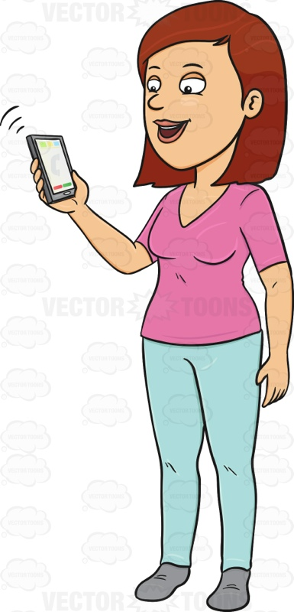

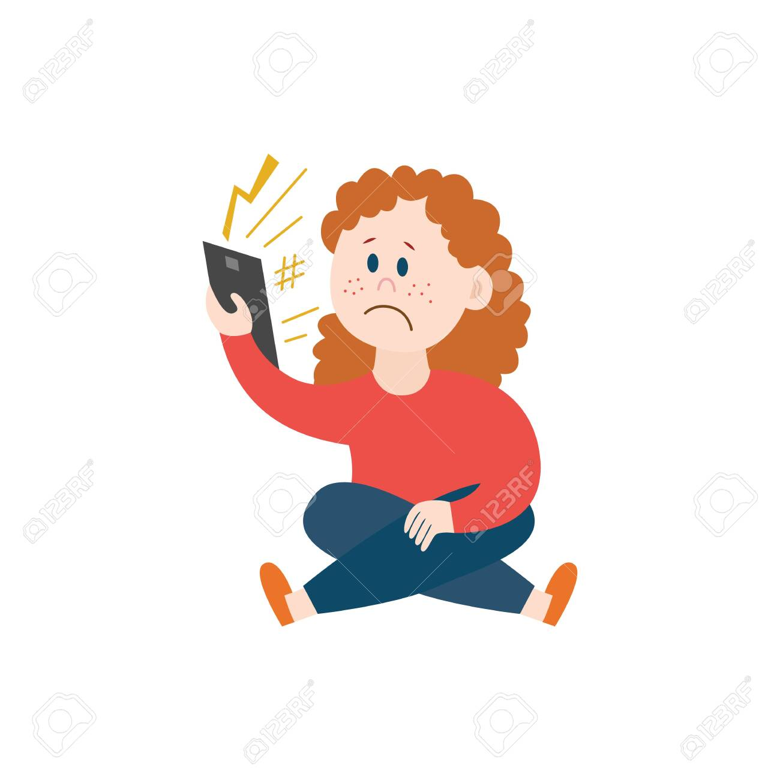
SOLUTION:
Notification:
Your Peer Needs Help
Notification:
Your Peer Need Help
Please Help Me!

Slide 6
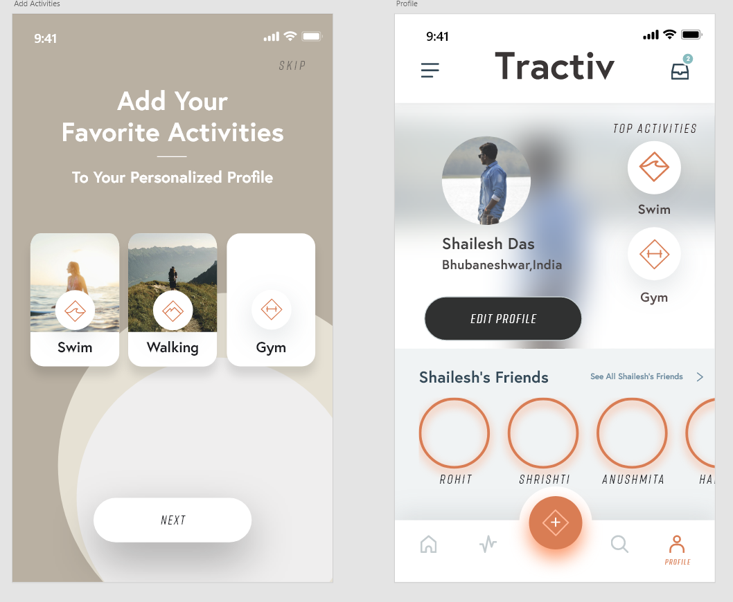
InTRoDUCTION
Internet of Things have brought about a rapid shift in dimension with respect to communication. In the era of IOT, the machines/sensors communicate to each other. IOT when merged with Data Science, can be used to automate a large variety of devices. Using the benefits of this system, we have automated the monitoring of human actions, which will be helpful in case of social and medical emergencies [1].
The accelerator and gyroscope sensors of the phone send the reading continuously to the server, where the readings are mapped to a particular activity. In case of any activity demanding quick support the peers are informed [2].

Slide 7
DrawBacks of manual system
All the actions leading to emergency conditions occur without prior knowledge.
Users might not be using mobiles in hand while having an medical emergency.
It may be inside the pocket.

Slide 8
Bliss of automation
Extract data from the sensors for a window.
Preprocess and analyse the extracted data.
Map the data, to a particular gesture
Send notification to the Peer in case of a gesture demanding immediate support.
Hence our systems does everything automatically and the users need not worry. Its like a 24 hour surviellance system, a guardian who monitors its users, maintaining a decent degree of privacy.

Slide 9
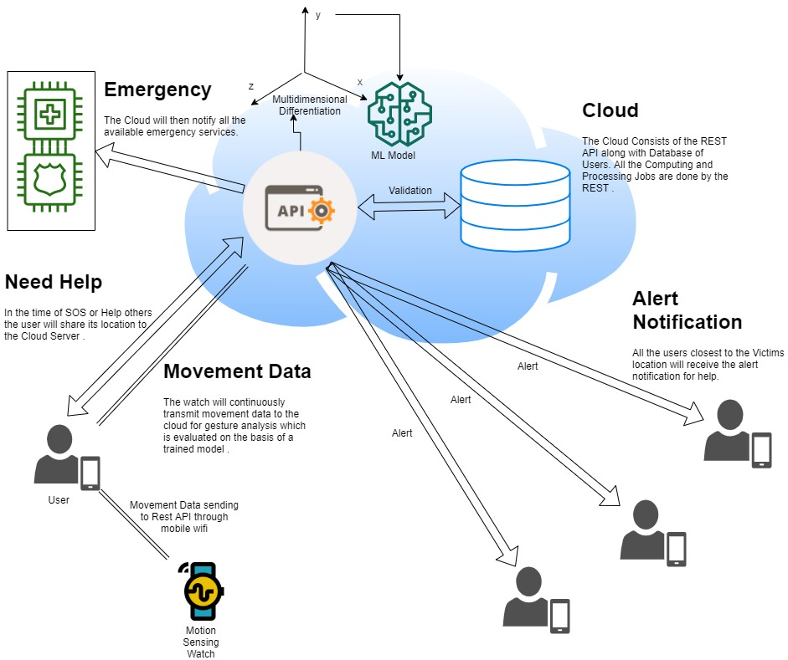
Project Architechture

Slide 10
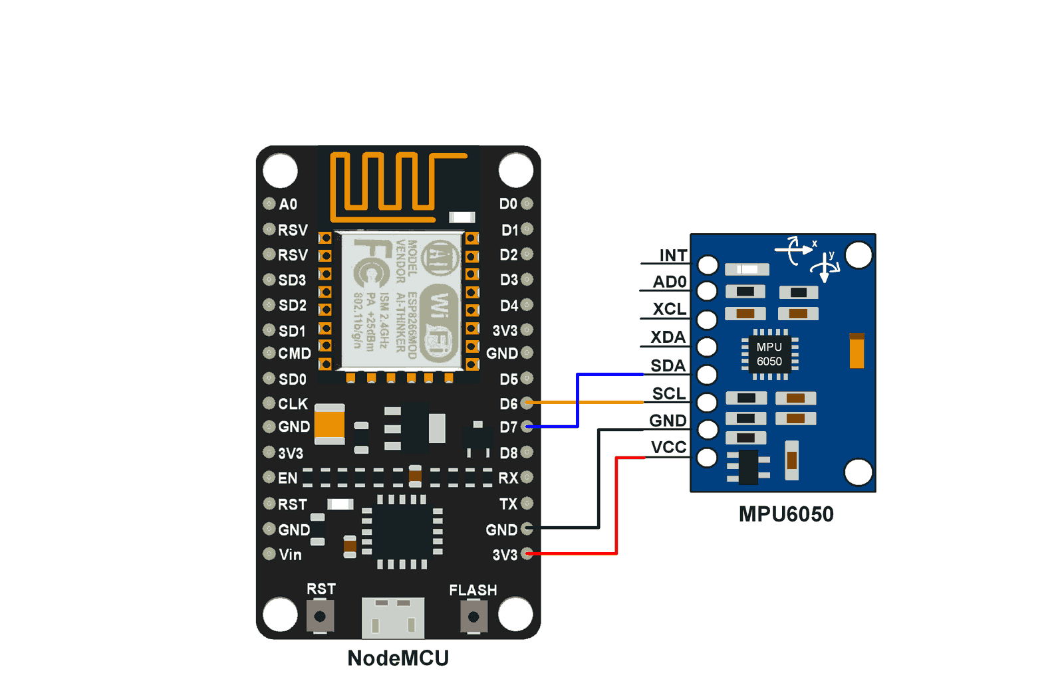
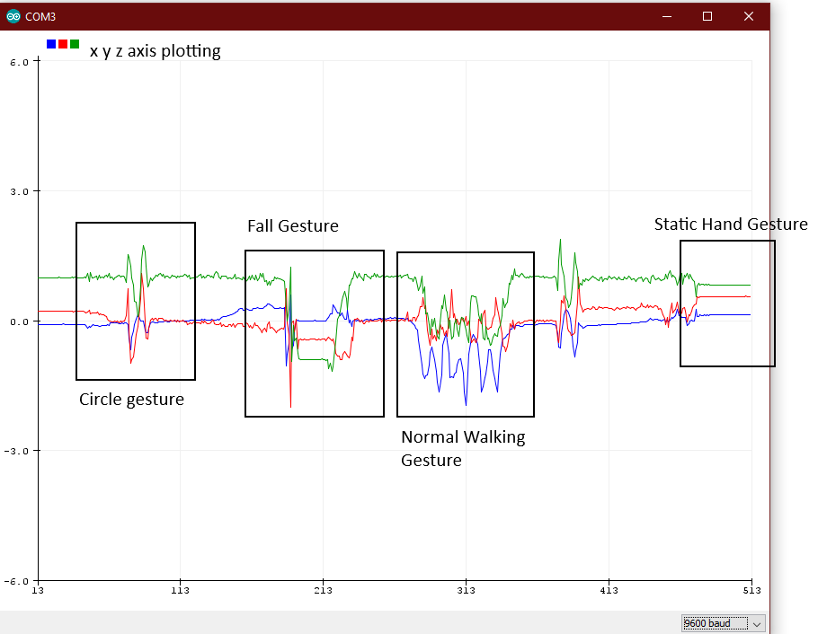
Insights to our motion sensing watch
Our Watch consists of 2 main Electronic Components – NodeMCU, MPU6050 sensor
MPU6050 sensor module is an integrated 6-axis Motion tracking device, Accelerometer 3-axis & Gyroscope 3-axis
NodeMCU with the esp8266 Wi-Fi module is used for connecting with Wi-Fi networks for the data Transmission to the Cloud.
The X,Y,Z axis readings when plotted live gives the following diagram.
Arduino IDE was used for the hardware programming and Python3 was used for software programming.

Slide 11
Use of datasets
The sensor datasets for different gestures are hardly available over the internet.
Our team, worked on creating multiple samples of data for differnent devices (mobile phone, watches) for different windows. There were data for 3 registered gestures (fall, accident, injustice to women), while remaining actions were grouped together forming a normal gesture.
For cell phones, the data extraction rate is relatively slower. Hence to provide accurate and fast decision making the window for the data is kept 20, with a delay of 10 milli-seconds, The dataset was relatively small, with 300 samples per associated gestures.
For fit-bands, the data extraction rate is faster. Due to low latency, the window for the data is kept 31, with a delay of 0.3 milli-seconds, with a further latency of 0.1 milli-seconds per axis. The dataset was large enough, with 1000 samples per associated gestures.

Slide 12
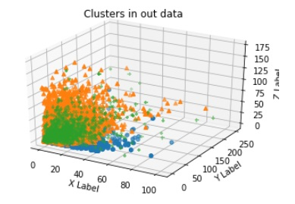
Associated Data analytics – multi dimensional differentiation
The normal extracted data cannot be mapped to any gesture. The data could not be clustered.
The data was transformed by a multi dimensional differentiation process, to make the data clusterable.

Slide 13
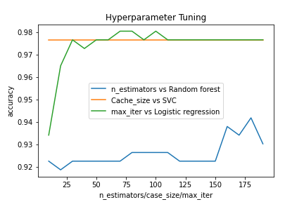
Efficiency of our model
The maximum accuracy of our approach from the trials was 98.06 % using logistic regression.

Slide 14
Insights to our android application
Application :
Registration
Login
Send sensor data in a window
If user thinks there might be an emergency and asks for help (SOS)
Server :
Verify registration credentials
Verify login credentials
Analyze the received data, map the data to a gesture,
If gesture is normal
If gesture demands immediate help or user presses SOS, Peers are notified.

Slide 15
Tradeoff between accuracy and Latency
As already mentioned, the test suite accuracy of our model is 98.66 %. For 150 trails 2 were predicted wrong. This is poor accuracy for real world applications. Because for 10 million trials, 13,333 will be predicted wrong, which might be false positive as well as false negative. The false negative cases will summon the inefficiency off our applications. Where as false positives will harras the peers without a cause.
Regarding the latency, we have kept a window of 1 second. So if we use overlapping data, our system is almost real time.
Thus our system kept the average tradeoff between accuracy and latency.

Slide 16
Conclusion
The major issues related to the similar applications are lack of proper databasemanagement. Apart from that, the most important feature lacking in these applications is automation. Victims to social injustice doesn’t have ample amount of time to open up the application and seek for help or inform their family members about their location. Our approach tries to resolve the issue by implementing automation. The accelerometer and gyroscope sensors of the mobile continuously measures theangular velocity and acceleration. So a particular gesture made using the cell phone can automatically trigger the help centers and the local guardians for help. Apart from that, the victims of the social injustice might not have enough time to access the mobile phones, so we have come up with a smart band which automatically tracks the gestures of the citizens. Any peculiar gesture will trigger the system. We have extended the functionality of this system for the elderly people who have an acute tendency to fall, with their family members left uninformed. The scope of the system includes detection of an accident, in case if anyone meets an accident with the gears on.

Slide 17
Future works
The major draw backs of our system include:
Latency in database transactions.
False positive and false negative cases.
Increasing the variations in gesture
All these challenges will be addressed in the future, and contribute a system that truly enhances social security.

Slide 18
References
[1] Gubbi, J., Buyya, R., Marusic, S. and Palaniswami, M., 2013. Internet of Things (IoT): A vision, architectural elements, and future directions. Future generation computer systems, 29(7), pp.1645-1660.
[2]https://en.wikipedia.org/wiki/Internet_of_things

Slide 19
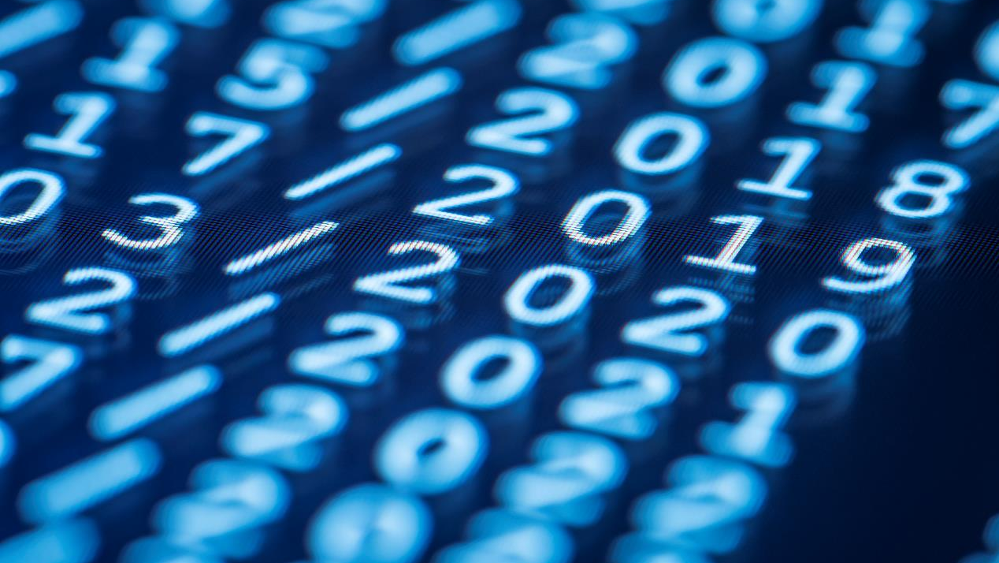
Thank You
1705819@kiit.ac.in
1705893@kiit.ac.in
1705924@kiit.ac.in
1705926@kiit.ac.in

